Slide 1
Instructions
Replace your photo with a headshot. If you need a headshot, please email anthonyc@uthscsa.edu
Edit the attached slide. Slide 2 is what we need. Slide 3 is an example.
Fill out the slide with your information and email back.
Do not add information that was not asked. Do not change the font and layout.

Slide 2
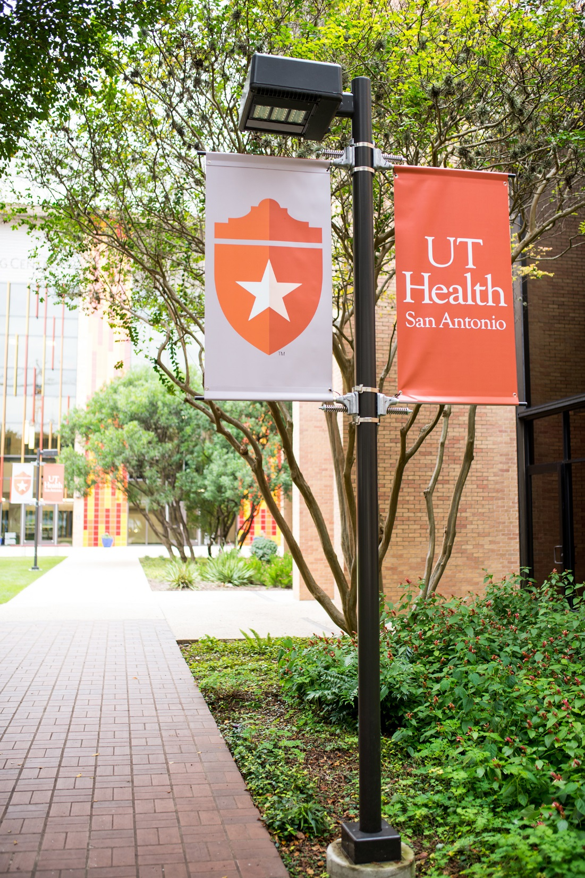

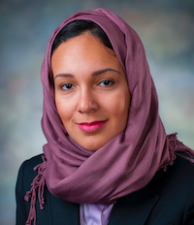


First Name Last Name
Program Name
Mentor Name:
Dissertation Title:
Research Interests: (These are keywords like Cell Biology, Pediatric Dentistry, Stem Cell Research)
Notable Awards:
Future plans after graduation

Slide 3
Sarah Abitbul
Master of Science in Dental Science
Mentor Name: Kenneth M. Hargreaves, D.D.S., Ph.D.
Dissertation Title: The Role of Analgesics In The Clinic
Research Interests: Periodontics
Notable Awards: Graduate Student Award, Best Poster Award
Sarah plans to work at a private practice dental clinic in her hometown of Seattle, Washington.

